Slide 1
Suren Gourapura
May 18, 2018
Weekly Progress Report

Slide 2
Readings
Read some of the ryanstutorials.net link on using Linux terminals
Watched videos on OpenClassroom up to Linear Regression II: Normal Equations
Watched videos and done quizzes on Coursera for all of week 1

Slide 3
Linear Regression I: Exercise 2
Problem: Use the provided data points to find a line of best fit using Gradient Descent
Create an iterative process that applies the Gradient Descent update to both slope and y-int simultaneously
Plot the data along with the best fit line
Also try to plot the solving process over a contour plot of J(theta)

Slide 4
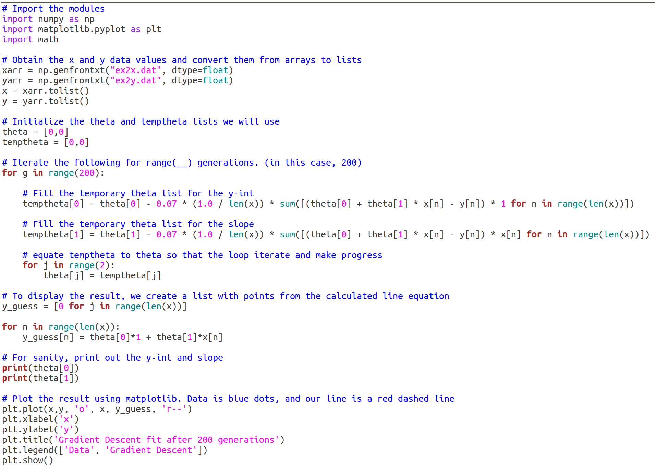
Lin. Reg. 1 Ex.2: using just for loops

Slide 5
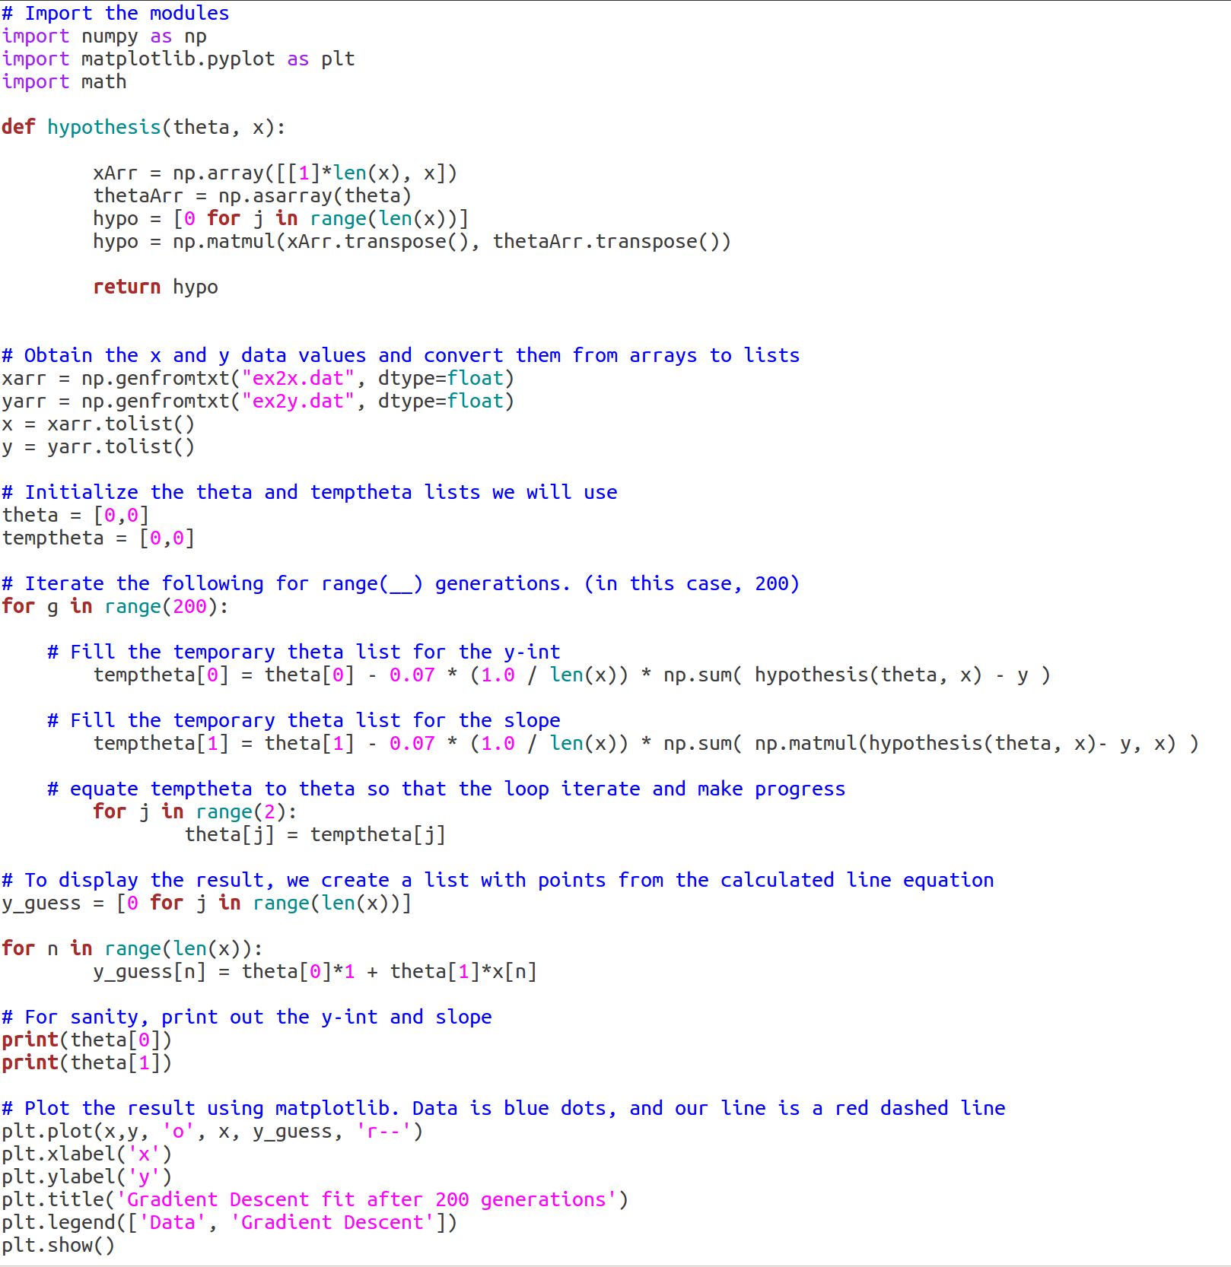
Lin. Reg. 1 Ex.2: using matrices for the hypothesis

Slide 6
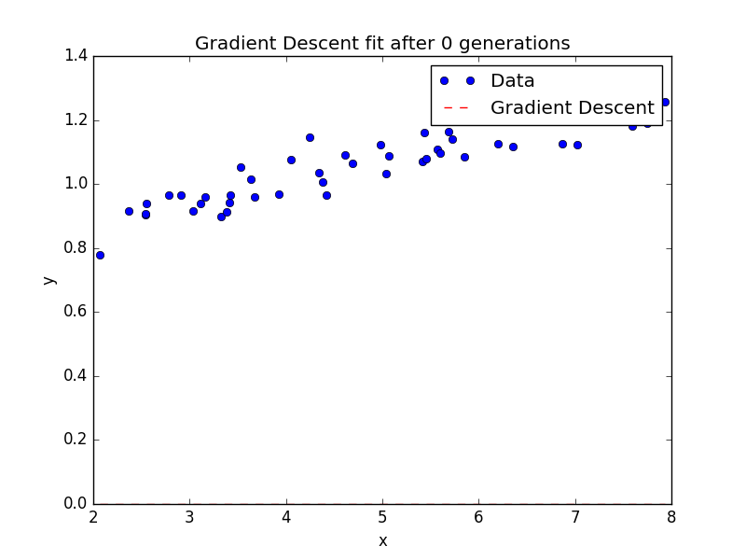
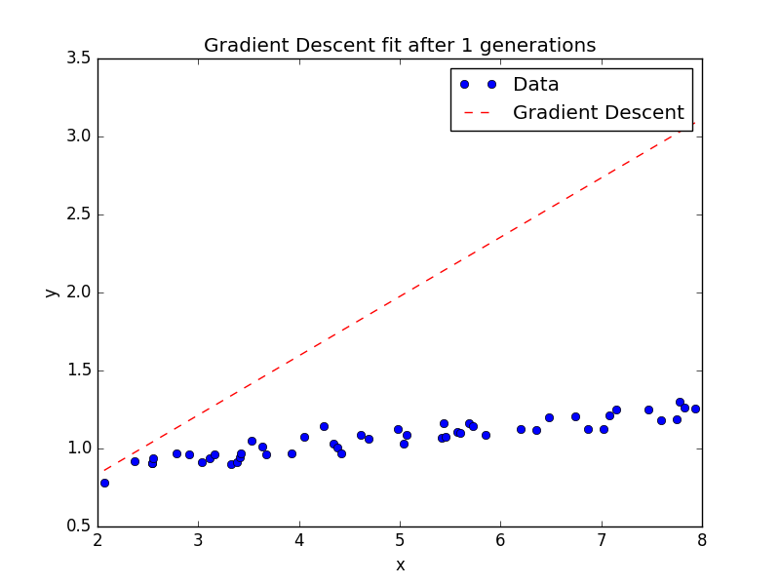
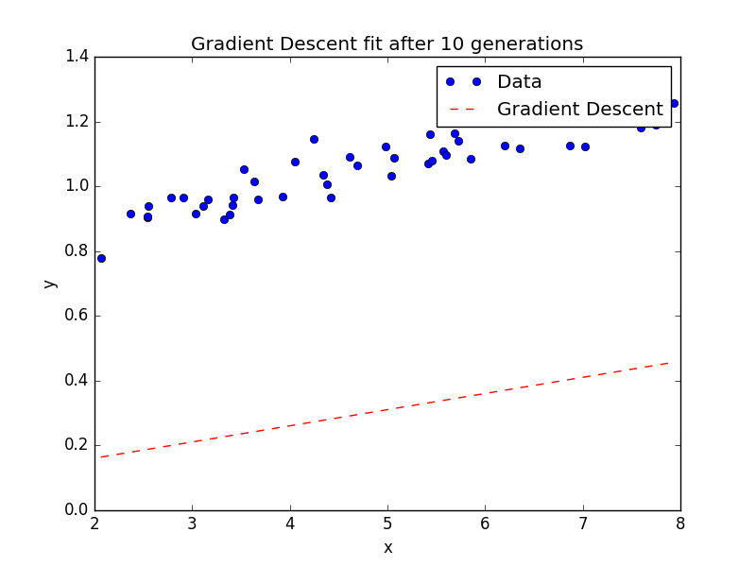
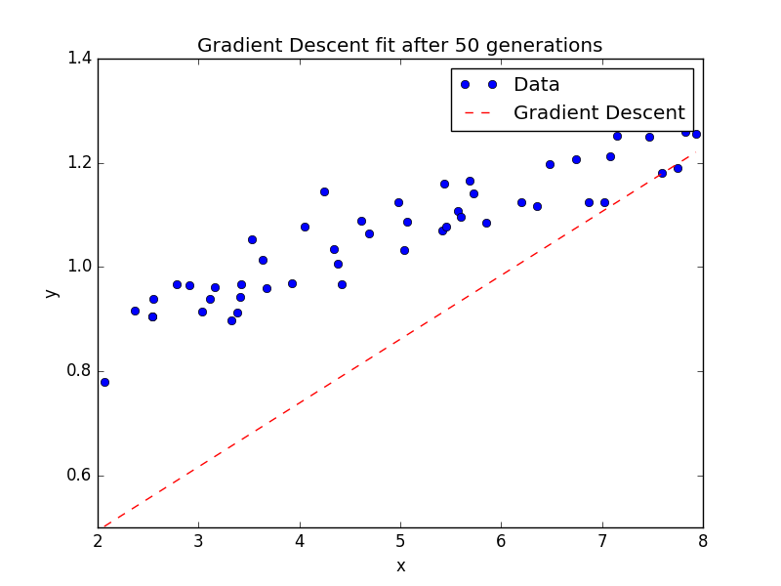
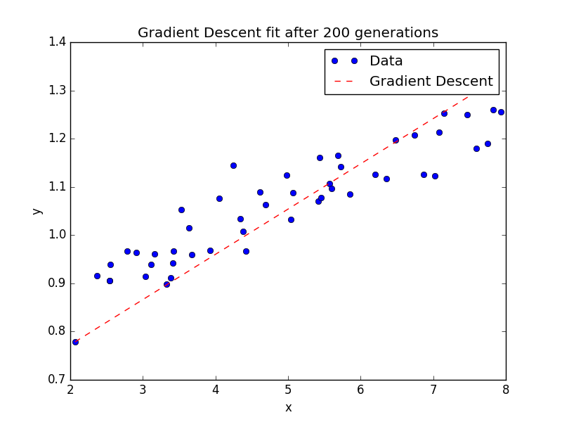
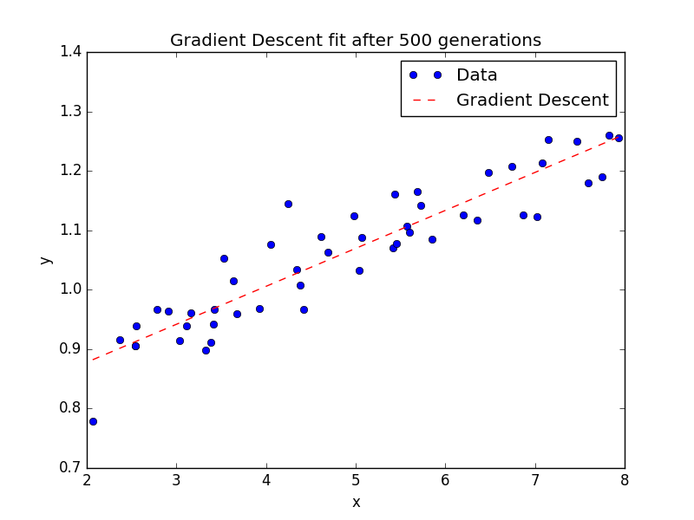
Gradient Descent Results

Slide 7
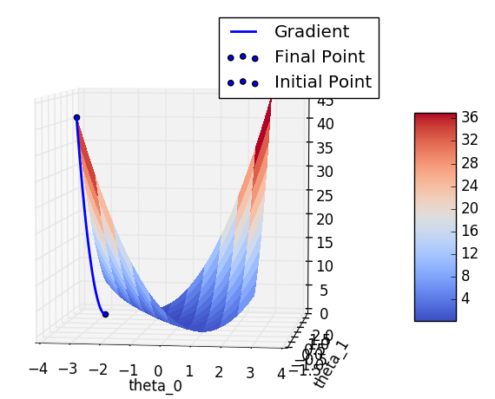
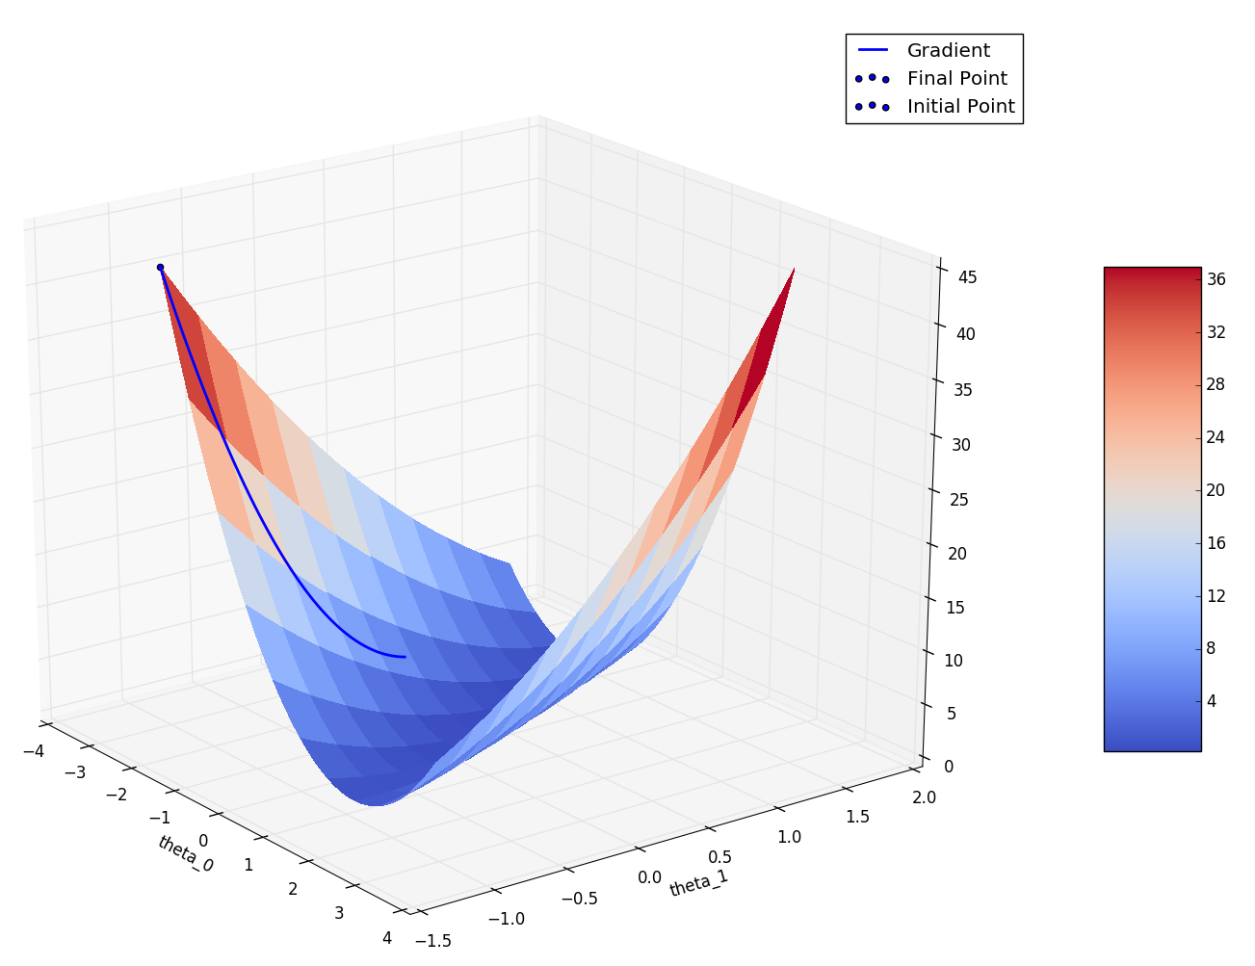
Results
Attempted to Plot the solving process: Did not succeed

Slide 8
Linear Regression II: Exercise 3
Problem: Use data with 2 features. Perform gradient descent. Show the effect of different alphas. Also use the matrix solution to find the exact theta values.
Modify previous Gradient Descent code for two features
Plot the data for various alpha values
Write code for calculating the exact theta values

Slide 9
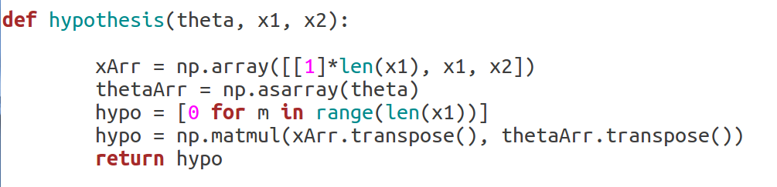
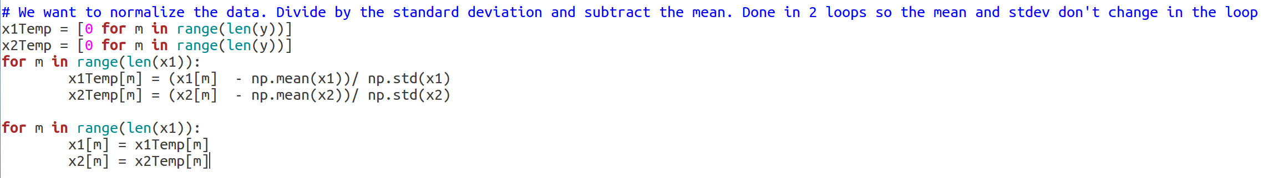
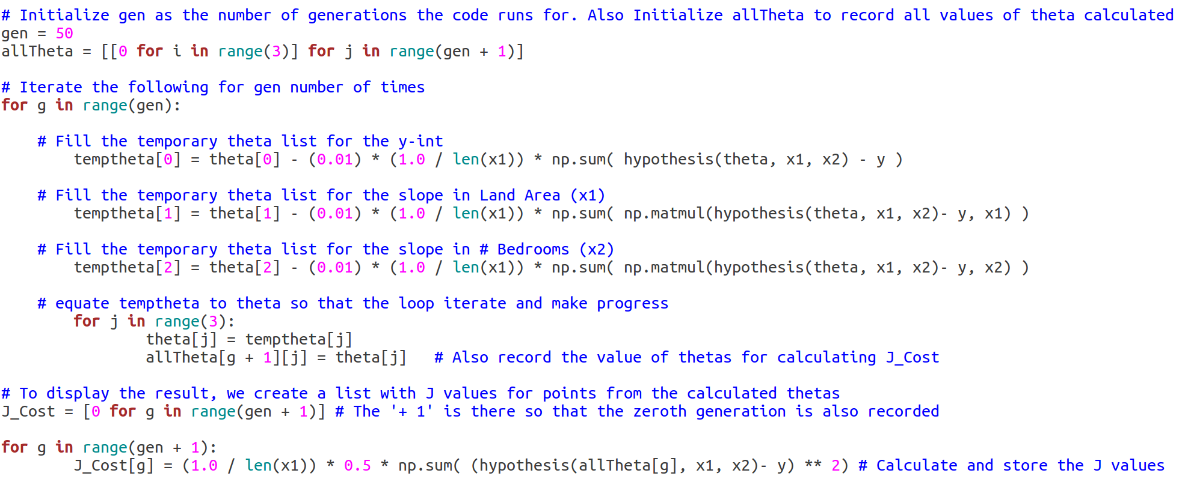
Lin. Reg. 2 Ex.3: Gradient Descent
Updated Hypothesis
Included data Normalization
Recorded all generated theta values

Slide 10
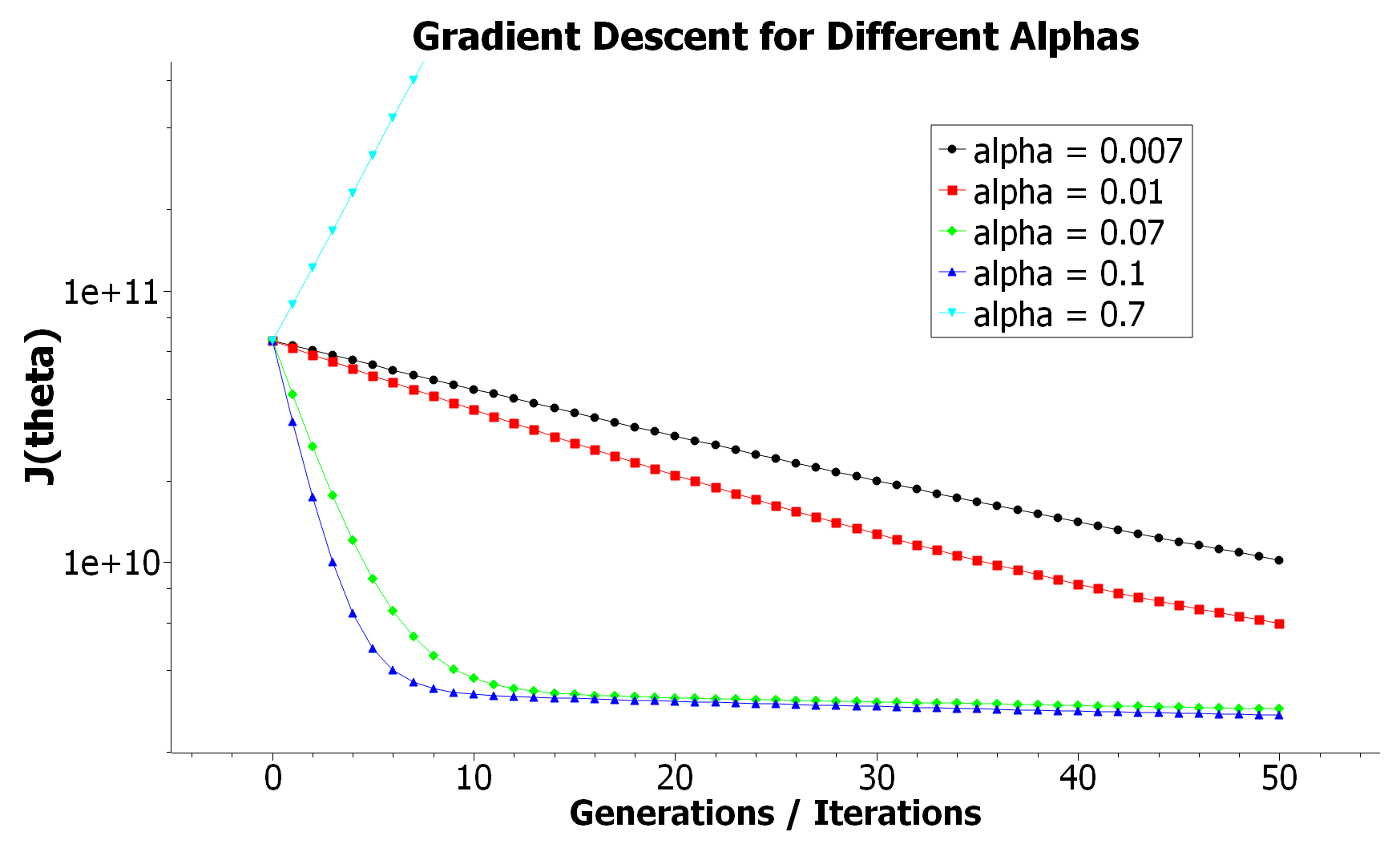
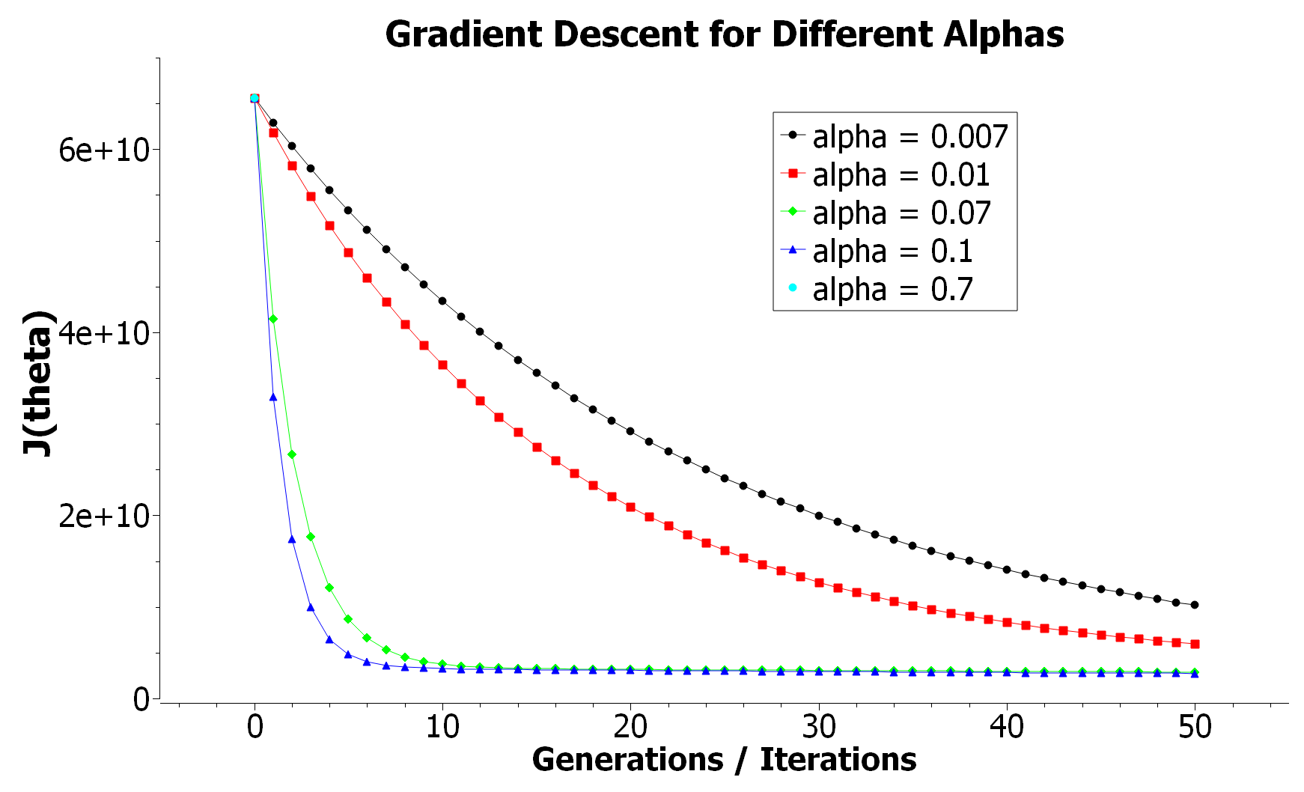
Gradient Descent Results
Log Plot
Normal Plot
Ideal Alpha ~0.1

Slide 11
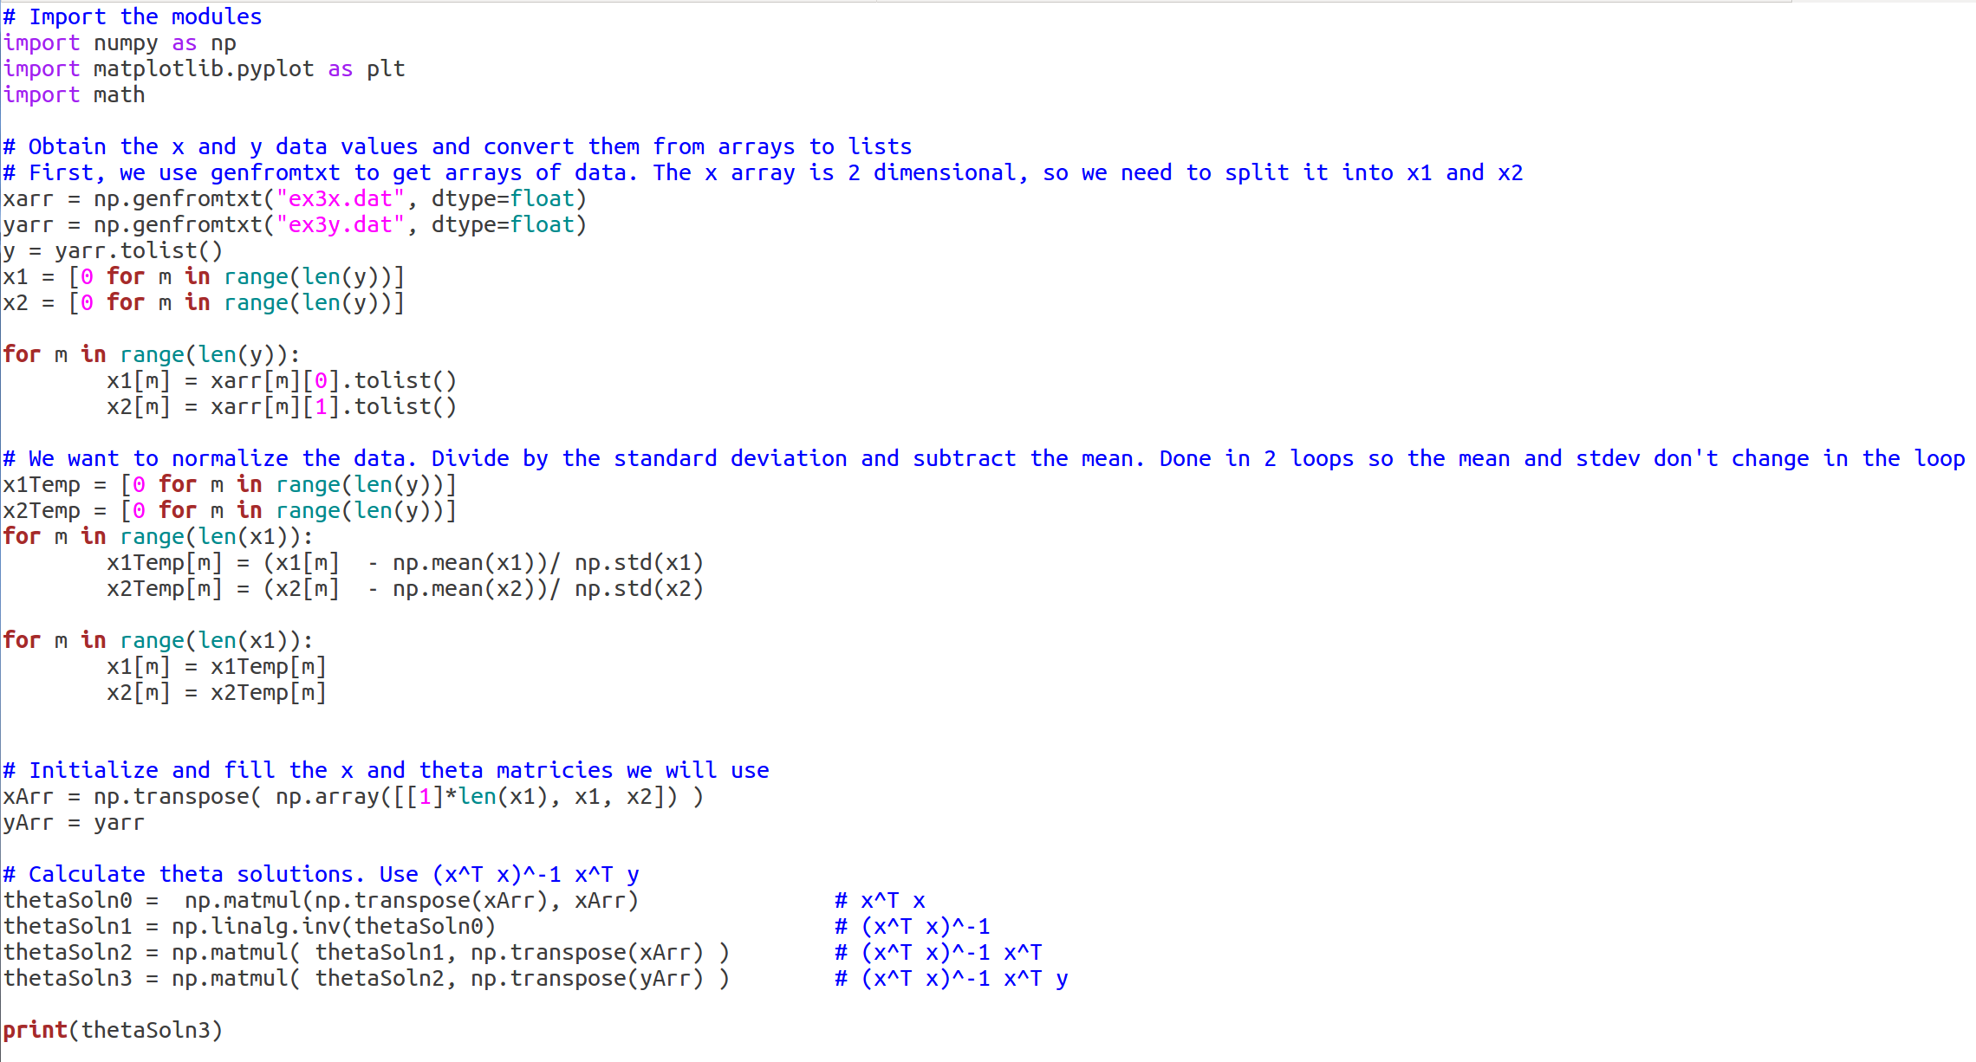
Lin. Reg. 2 Ex.3: Normal Equations

Slide 12
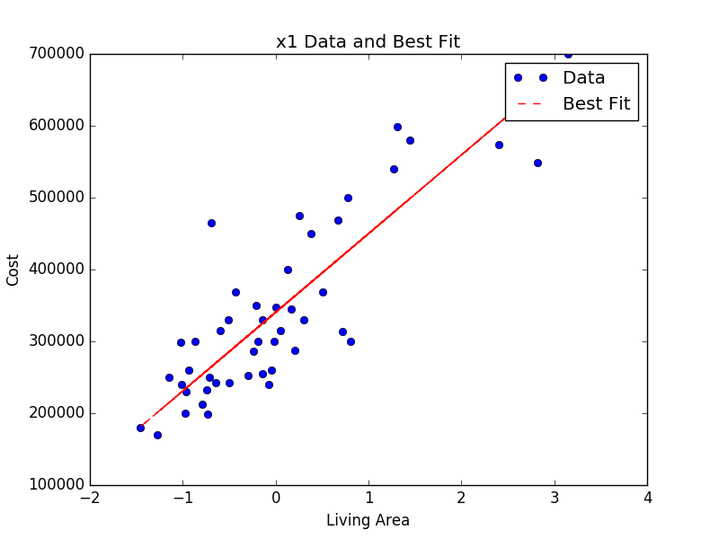
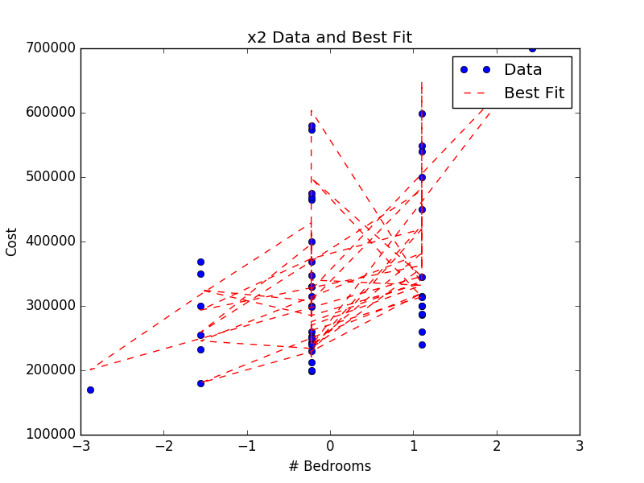
Normal Equations Results
Best Theta = [ 340412.65957447, 109447.79646964 , -6578.35485416]

Slide 13
Possible Additional Work
For ex.2: Try plotting the 3D contours with gradient descent again.
For ex.3: Make a 3D plot of the best fit line through the data

